Slide 1
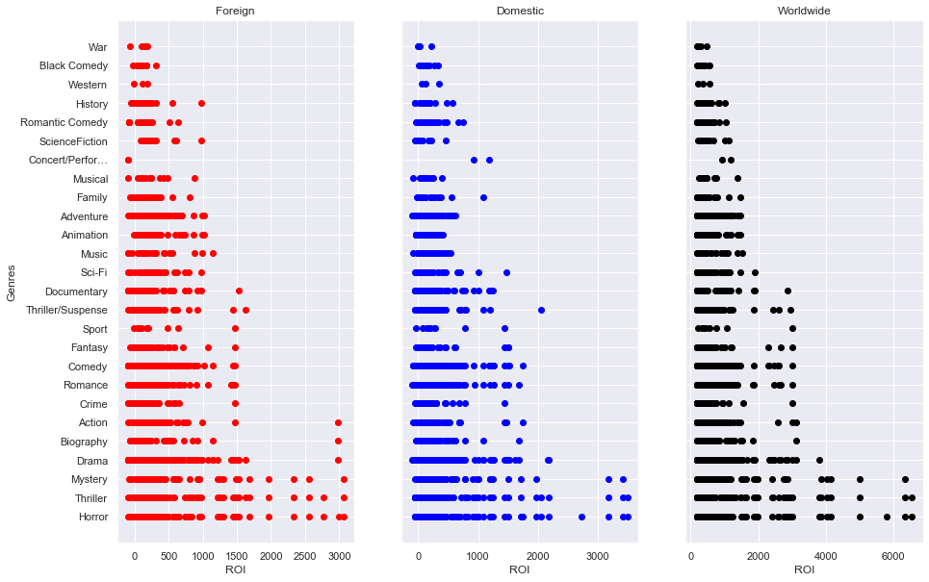
ROI by Genre (2010-2019)

Slide 2
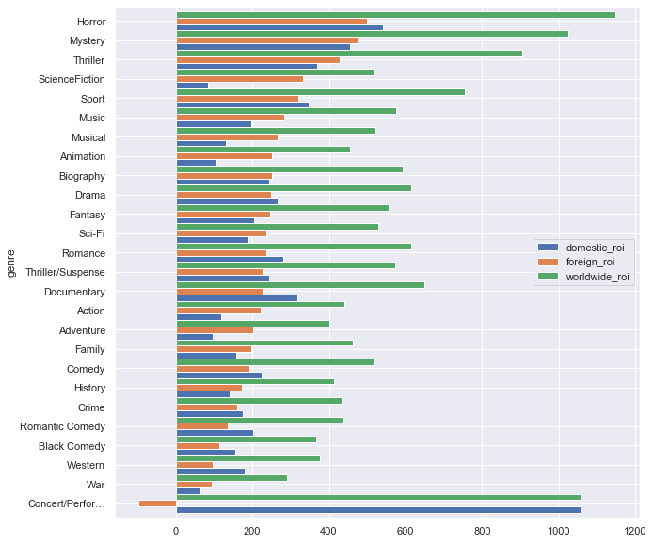
Average ROI by Genre (2010-2019)
When targeting foreign audiences, Horror/Mystery/Thriller genres give the highest return of investment.
Science Fiction, Animation, Musical, Adventure, Action genres have a higher average foreign ROI compared to domestic values.
Data excludes 2 films (ROI above 6000):
The Gallows (Horror)
The Devil Inside (Horror)

Slide 3
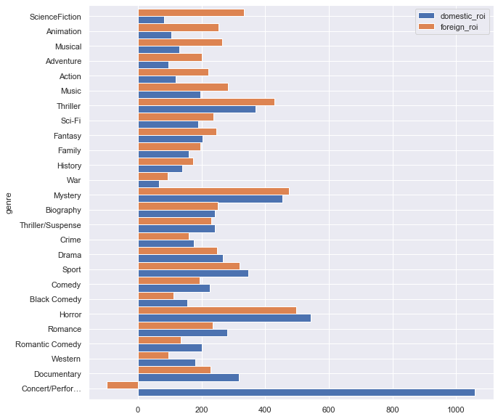
Average ROI by Genre (2010-2019)
Science Fiction, Animation, Musical, Adventure, Action genres have a higher average foreign ROI compared to domestic values.

